Slide 1
Semantic Web Technologies in the Music Domain
Andrea Poltronieri
Department of Computer Science and Engineering (DISI)
andrea.poltronieri2@unibo.it

Slide 2
INDEX
01
02
03
04
MUSICAL BACKGROUND
MUSIC ONTOLOGIES
CASE STUDIES
EXERCISE

Slide 3
01
MUSICAL BACKGROUND
Notes:
But first of all a little bit of context

Slide 4
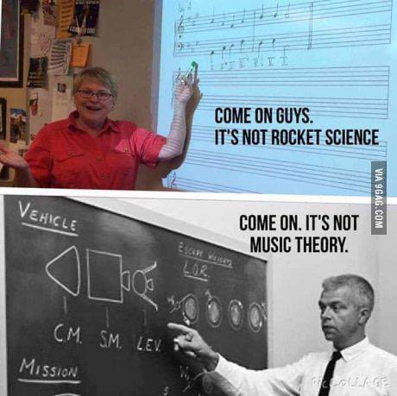
Music (theory) Background

Slide 5
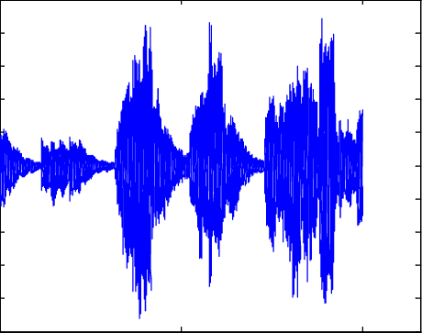
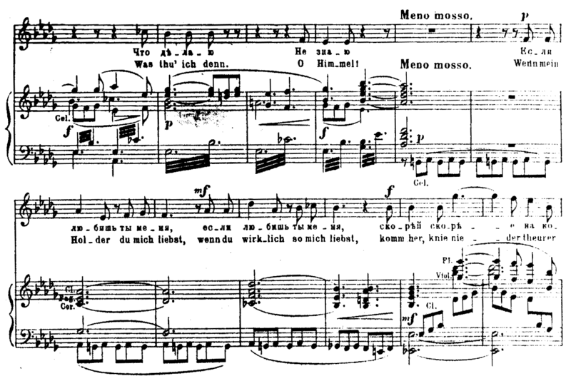
Representing Music
Audio Signal
Symbolic Representation

Slide 6
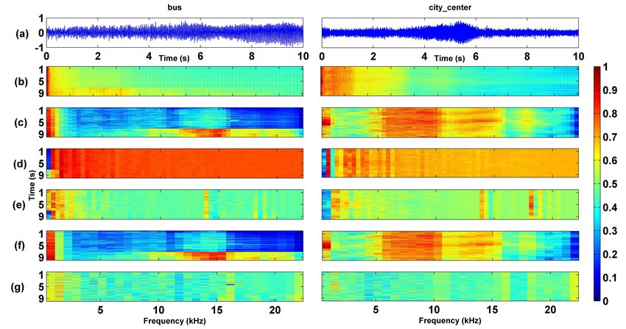
Audio Signal
Low structural generality
High expressive completeness

Slide 7
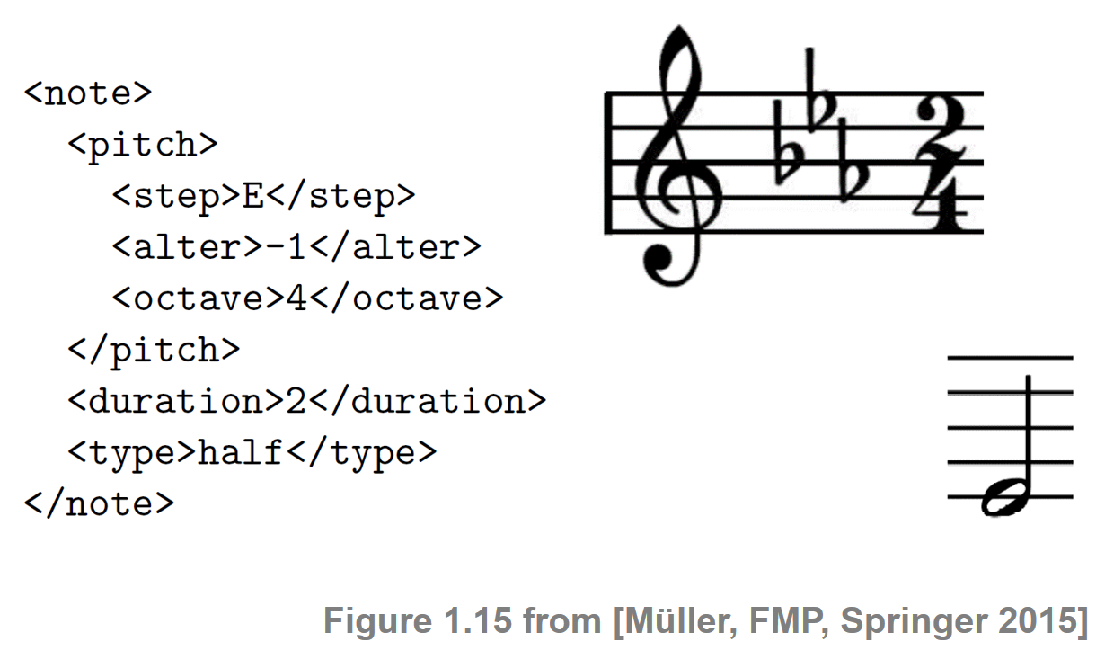
Symbolic Representations
High structural generality
Low expressive completeness (e.g. timbre information usually overlooked)

Slide 8



Music Similarity
Music similarity is a defined as the ability to measure the similarity between music tracks
Central task in Music Information Retrieval
Central in many fields:
Classification
Recommendation
Search
Crucial for Musicology

Slide 9


Music Similarity
Music similarity can be approached from two different perspectives:
Context-based Similarity
Content-based Similarity
Non-musical data:
Metadata
Song popularity
Listener’s preferences
Musical data

Slide 10
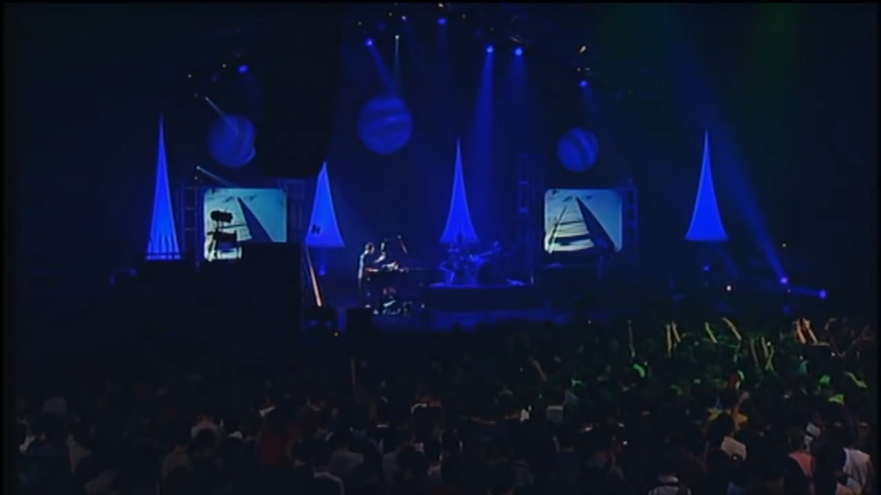
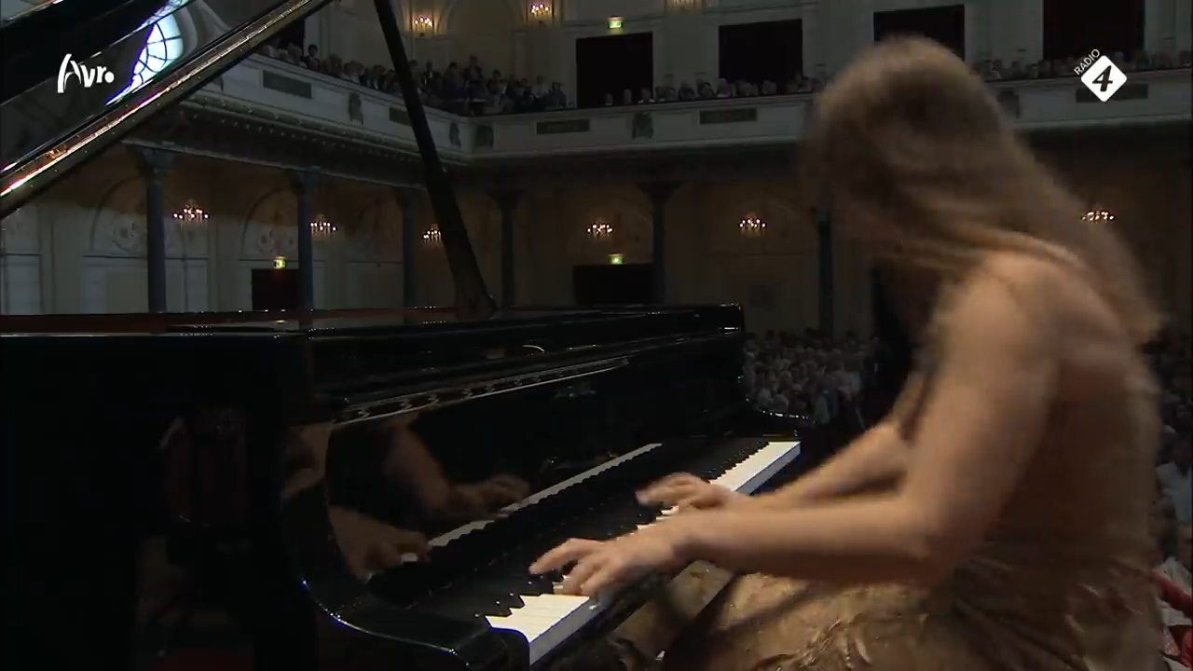
Muse - Space Dementia
Can you hear any similarity between the two compositions?
?
Muse – Space Dementia (2001)
Rachmaninoff – Piano Concerto no. 2 (1901)

Slide 11
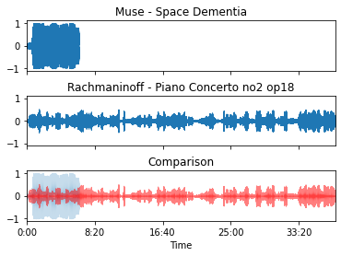
Audio signal analysis is not enough

Slide 12
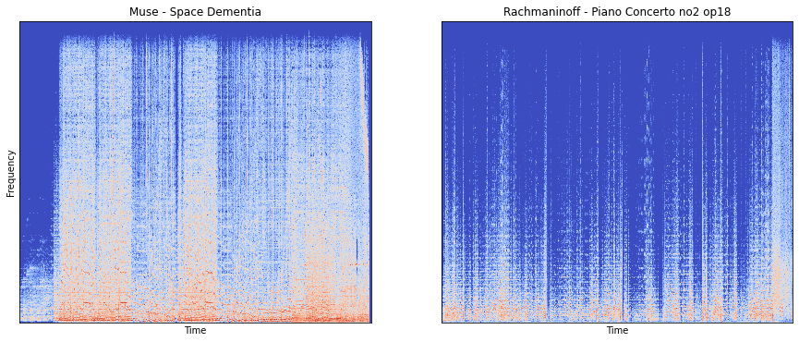
Audio signal analysis is not enough (2)

Slide 13
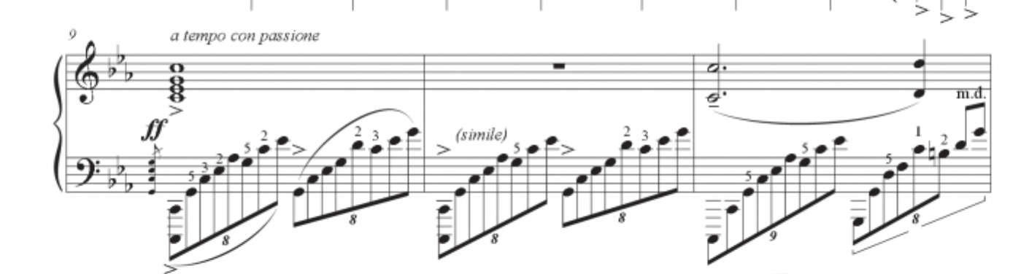
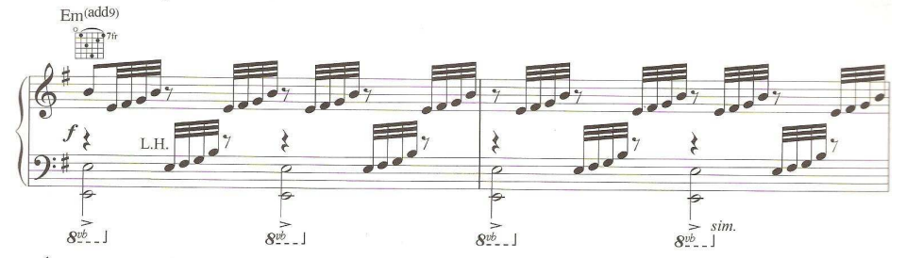
Symbolic similarity
Same pattern
Different key
Different tempo
Rachmaninoff – Piano Concerto no. 2 (1901)
Muse – Space Dementia (2001)

Slide 14
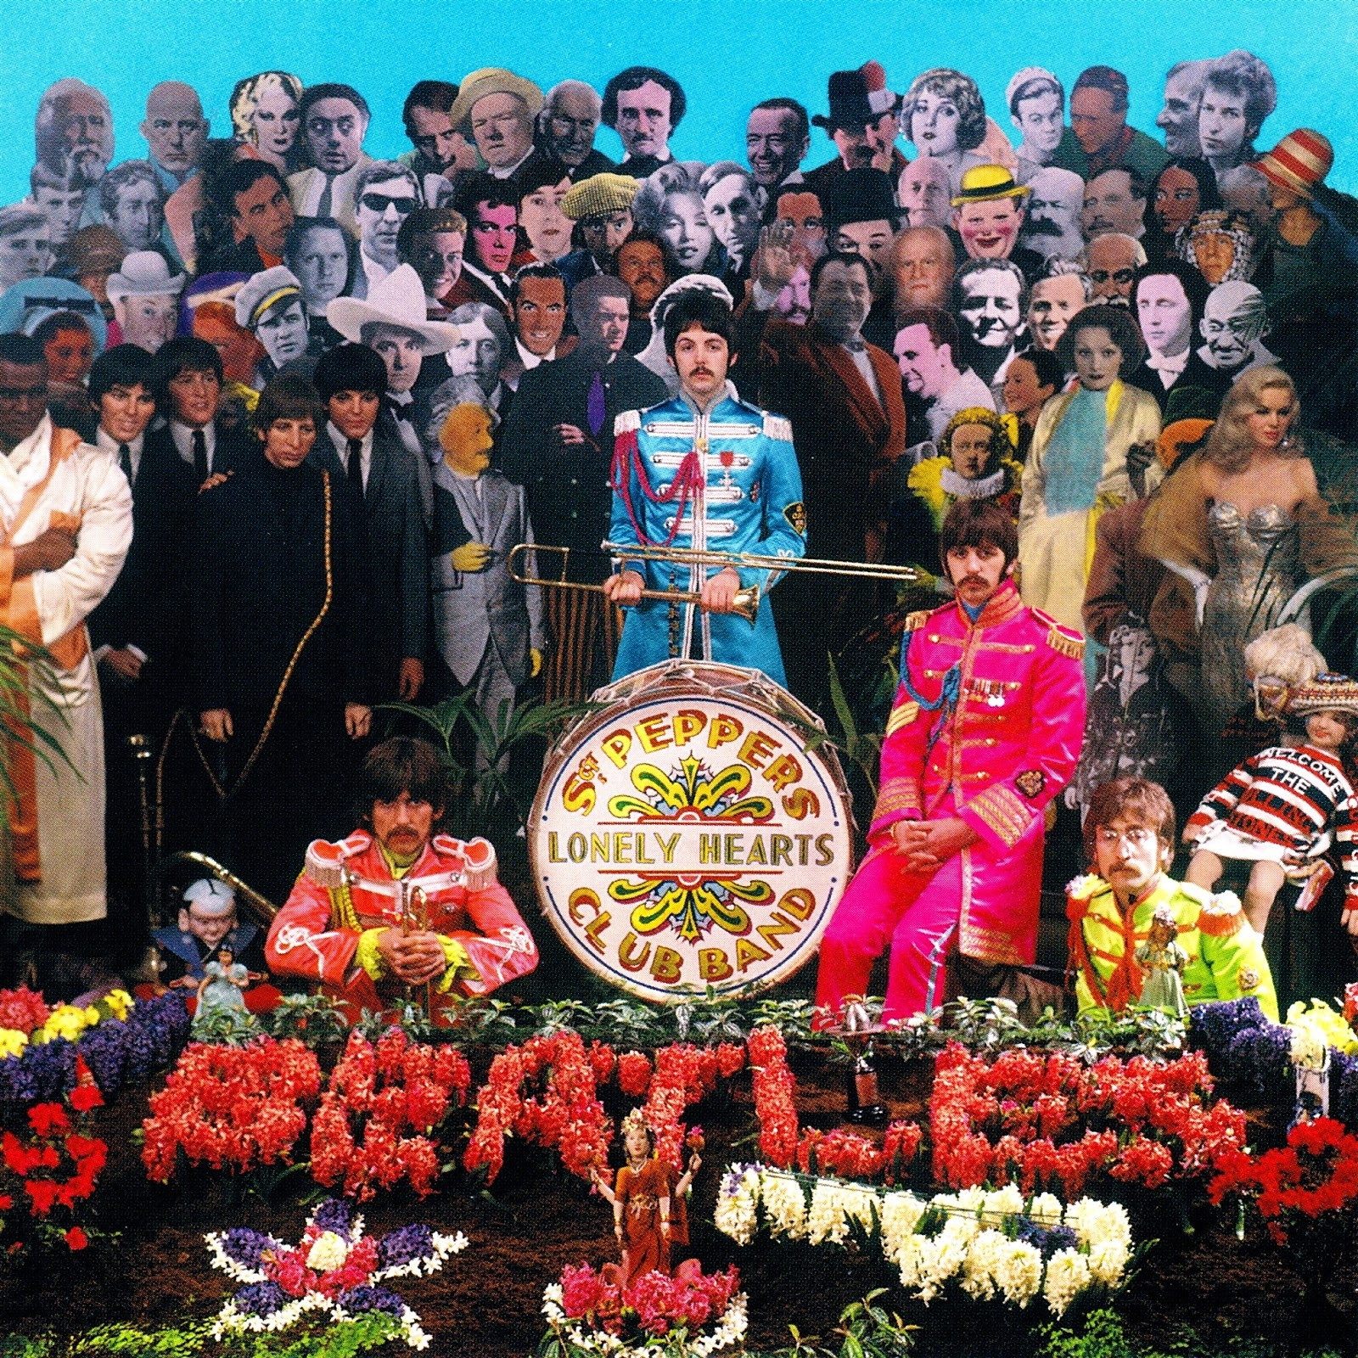


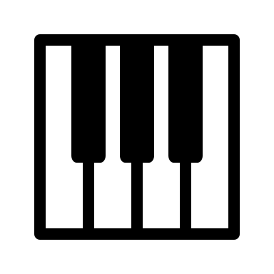

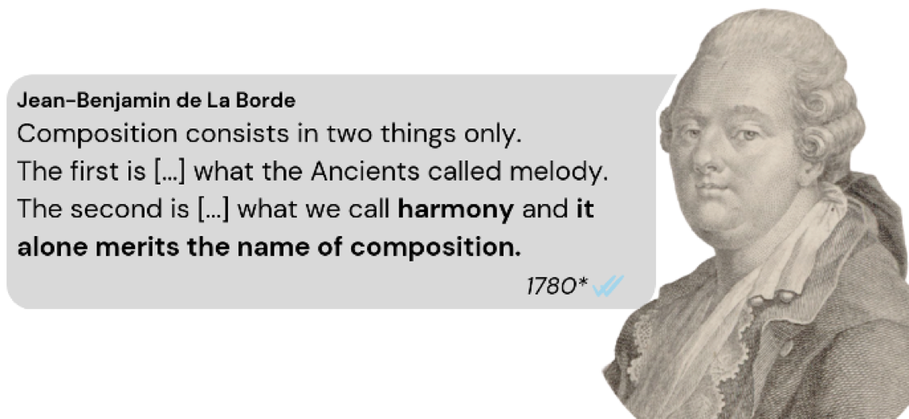
What is a music composition?
A musical composition is composed by three main elements:
+
+
Rhythm
Harmony
Melody
Notes:
A music composition is composed by three main elements
All these three elements mixed together result in a music piece
Harmony has a special role in a composition, as de La Borde pointed out in the late 18th century, where he claimed that harmony alone merits the name of the composition.
This is why in this first version of Harmory we only deal with harmony and harmonic annotations

Slide 15
What is harmony?
In music, harmony is the process by which individual sounds are joined or composed into whole units or compositions.
Harmony is usually represented through chords.
C:maj7
Is composed by
{C,E,G,B}
Chord
Pitch Classes
Has function
Has key
I [tonic chord]
Has time
Function
4 beats
C major
In key
Duration
Key

Slide 16
Today’s topics
Today we are going to expore some ideas on how to use Semantic Web Technologies can be used for:
Representing musical data (harmonic data, melodic data, annotations, metadata, etc.)
Describing music similarity
Enhancing machine creativity.

Slide 17
02
MUSIC ONTOLOGIES

Slide 18
Overview of exsisting Music Ontologies
METADATA
MUSIC THEORY
MUSIC NOTATION
AUDIO SIGNAL
Music Ontology
Music Theory Ontology
Music Score Ontology
Audio Features Ontology
DOREMUS
Temperament Ontology
MIDI-LD
Studio Ontology
MUSO Ontology
Tonality Onotology
MusicOWL
Audio Effects Ontology
Performed Music Ontology
Chord Ontology
MusicXML Ontology
CALMA Ontology
OnVIE Ontology
FunctionalHarmony Ontology
Charm Ontology
Smart Instrument Ontology

Slide 19
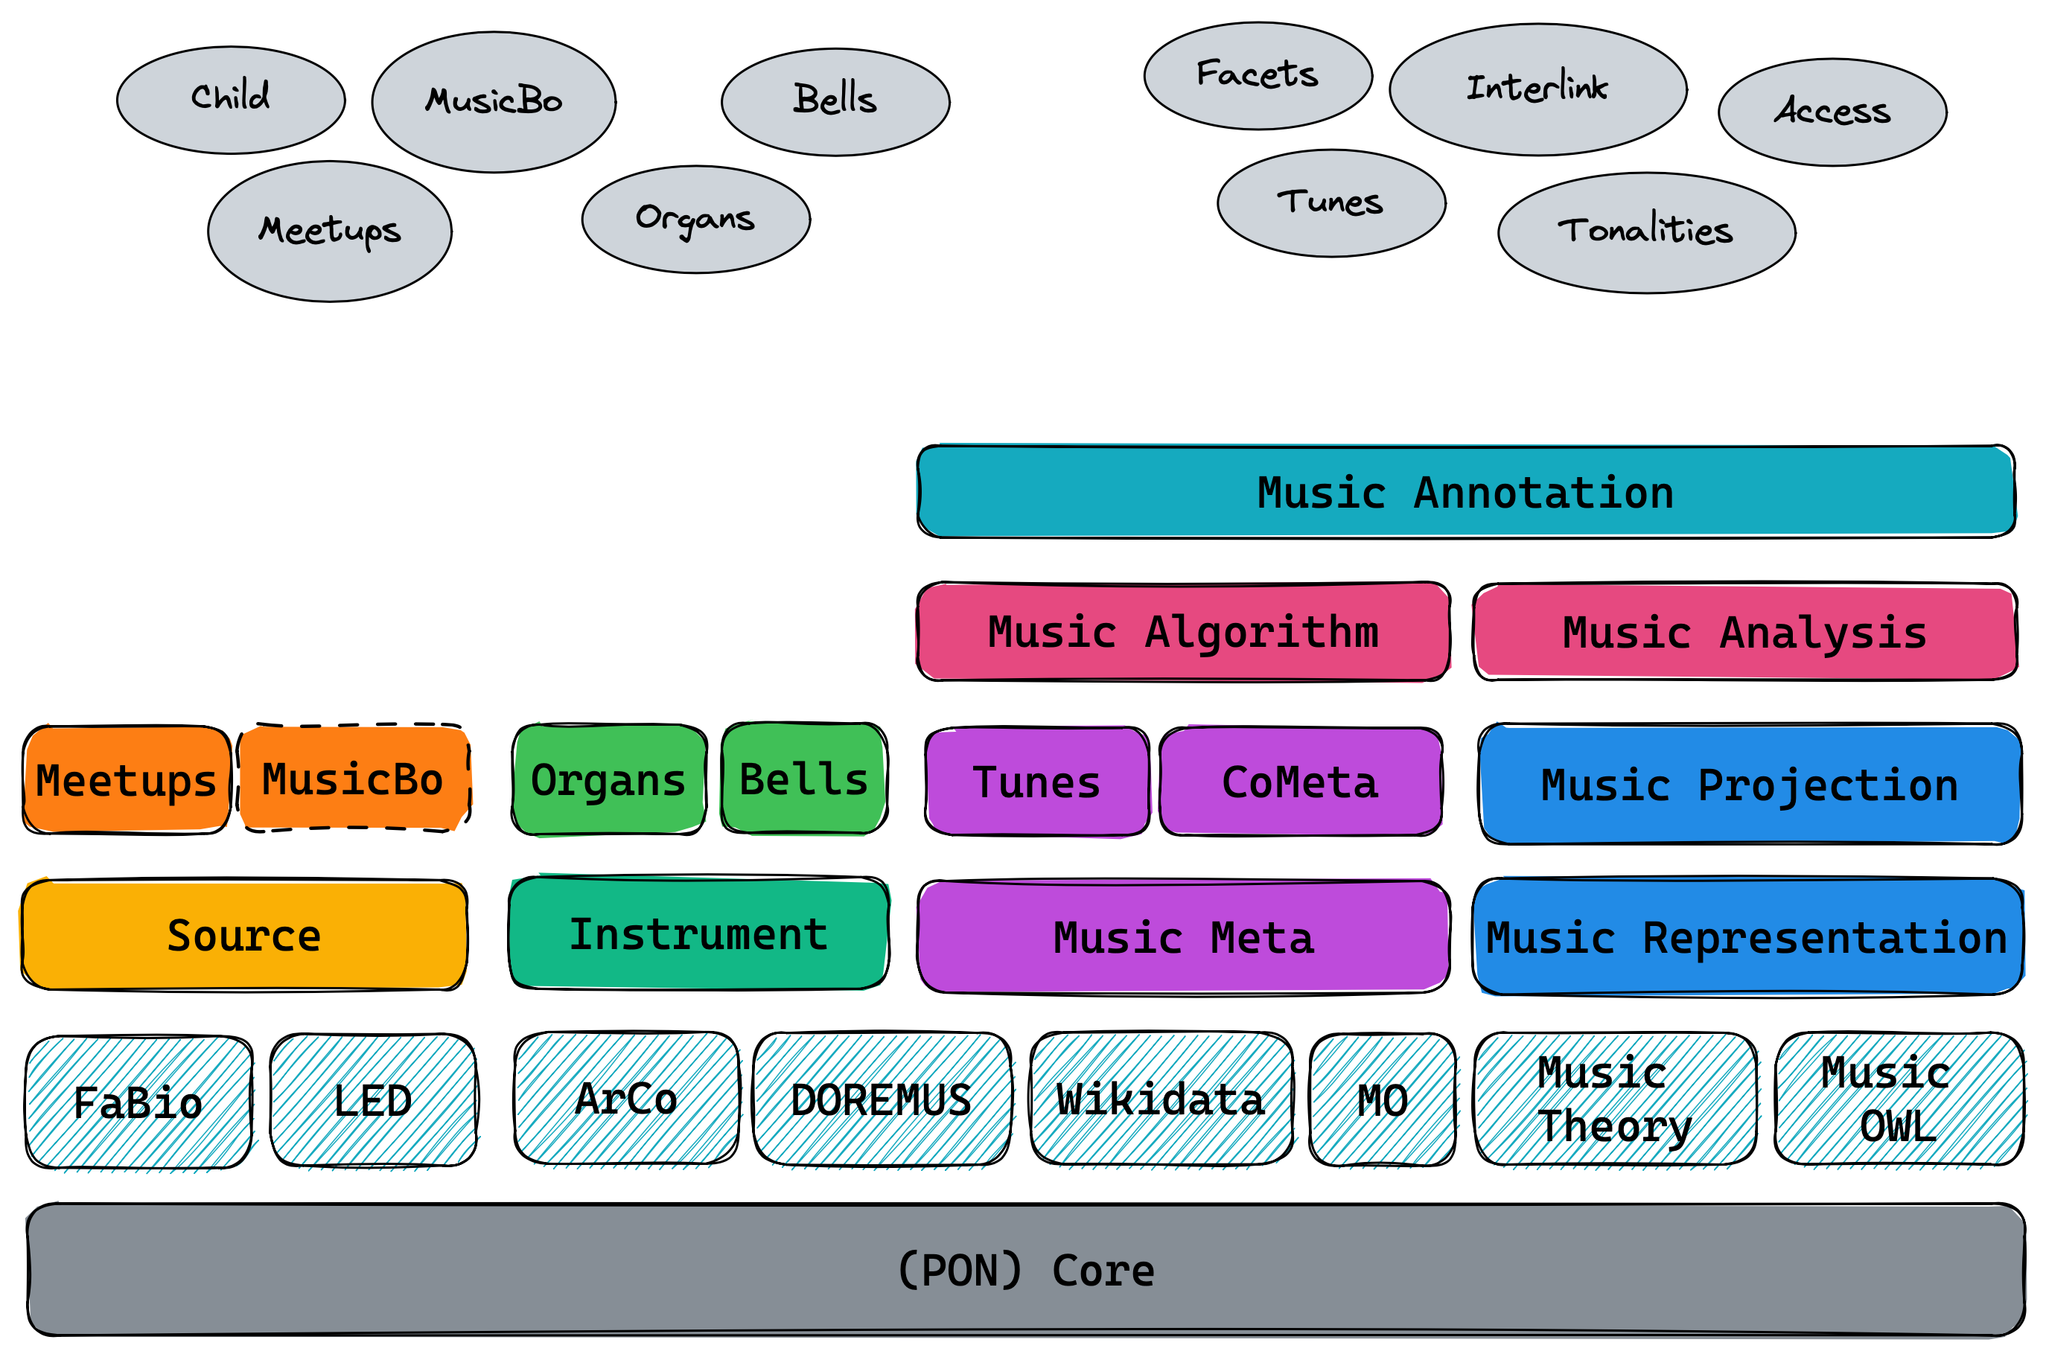
The Polifonia Ontology Network (PON)
PON is a network of ontologies that can be used for describing heterogenous information in the music domain
https://github.com/polifonia-project/ontology-network

Slide 20
03
CASE STUDIES

Slide 21
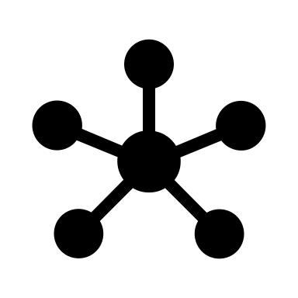

CASE STUDIES
ChoCo: The Chord Corpus
Case Studies
I will be introducing two different (yet related) projects which show an interaction between music and the Semantic Web:
Harmory: The Harmonic Memory

Slide 22

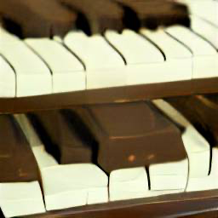

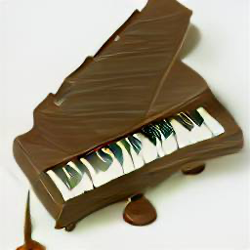
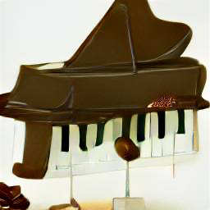
Terminology (in this presentation)
Chord annotation: the output of a human expert (or a computational method) identifying chords in a piece.
(synonyms here: a sequence of chords / a chord progression)
Chord observation / occurrence: the atomic elements of a chord annotation – the individual chords.
Tonality: given by the key (e.g. C) and the scale (e.g. “maj”).

Slide 23


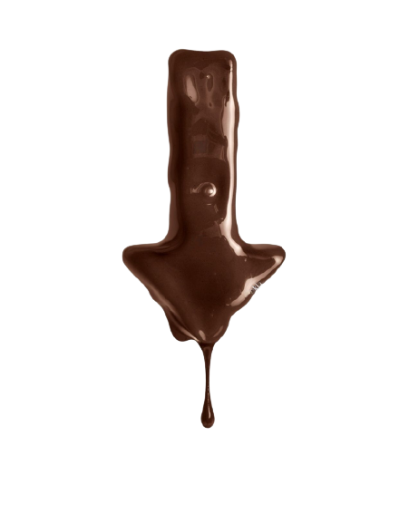
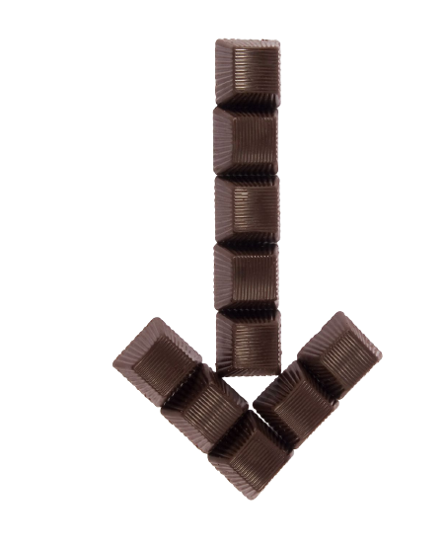
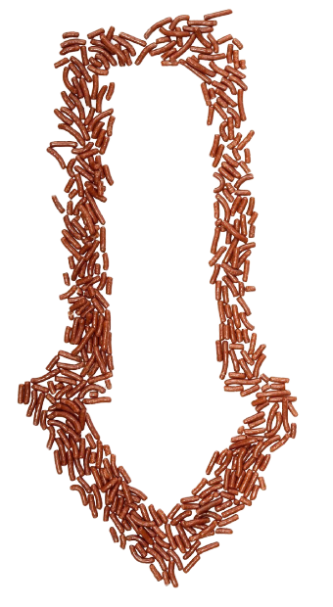


ChoCo in a nutshell
FROM
18 datasets
14 formats
9 notations
TO
1 dataset
2 outputs
2 notations

Slide 24
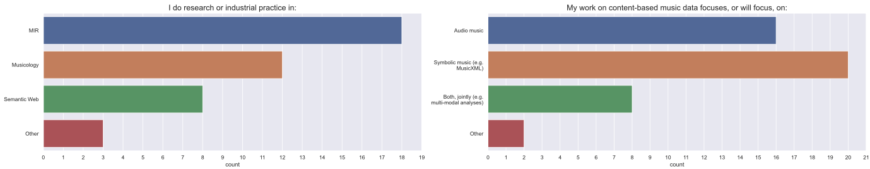
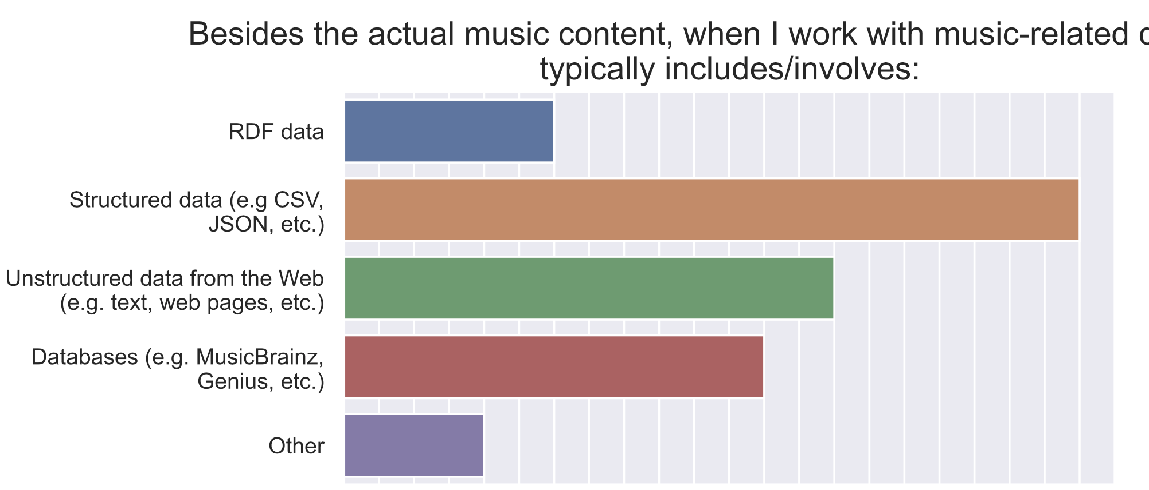
The need for ChoCo

Slide 25
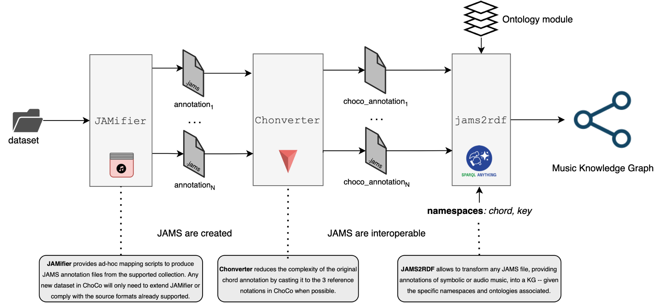
ChoCo
Data transformation workflow

Slide 26
ChoCo
Jamifier
Challenge 1: little or no use of annotation standards
CSV
TXT
LAB
MGU
HAR
RomanText
iReal
xLAB
JAMS
ABC
SKU
DCMLab
JSON
MXL
SQL

Slide 27
ChoCo
2. Chonverter
Challenge 2: too many chord notations
Leadsheet Notations
e.g. Eb-7/Bb
Roman Numeral Notations
e.g. viio7/V
Polychord Notation
e.g. A3,C4,E4,E5
Harte
music21
iReal
Roman Numeral
Weimar
ABC
Jazz
corpus
Jazz Parser
Harte Notation

Slide 28
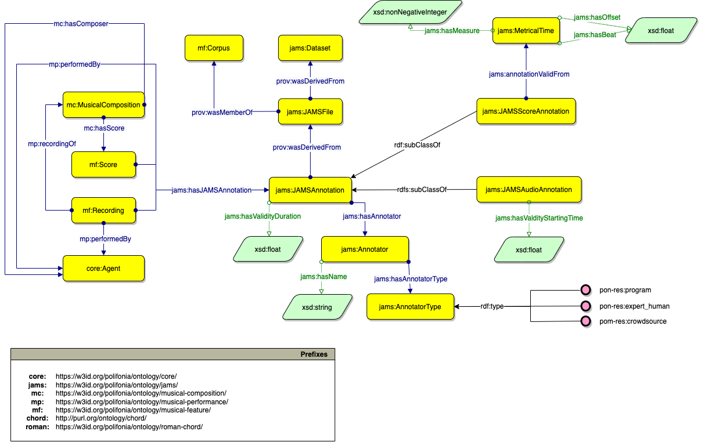
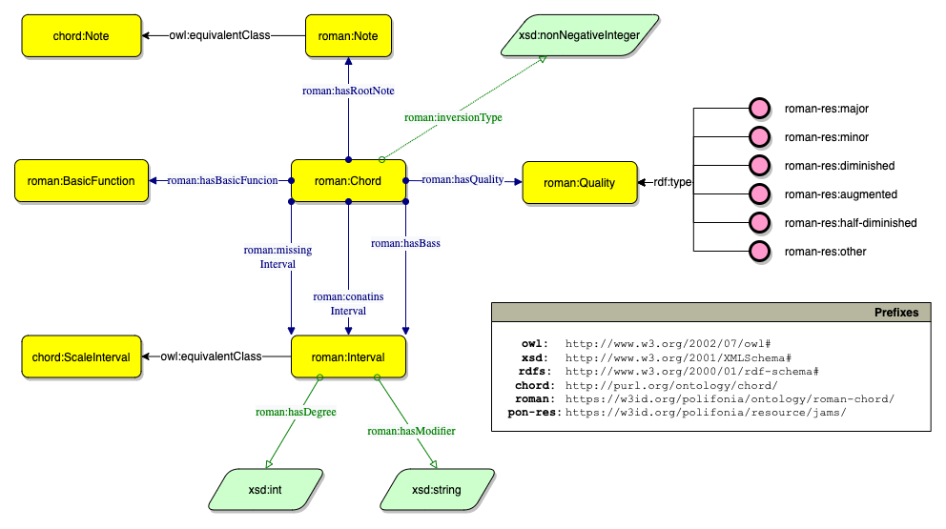
ChoCo
3. KG Generation
Challenge 3: making ChoCo data available and interoperable
Excerpt of the JAMS Ontology
Excerpt of the Roman Chord Ontology

Slide 29

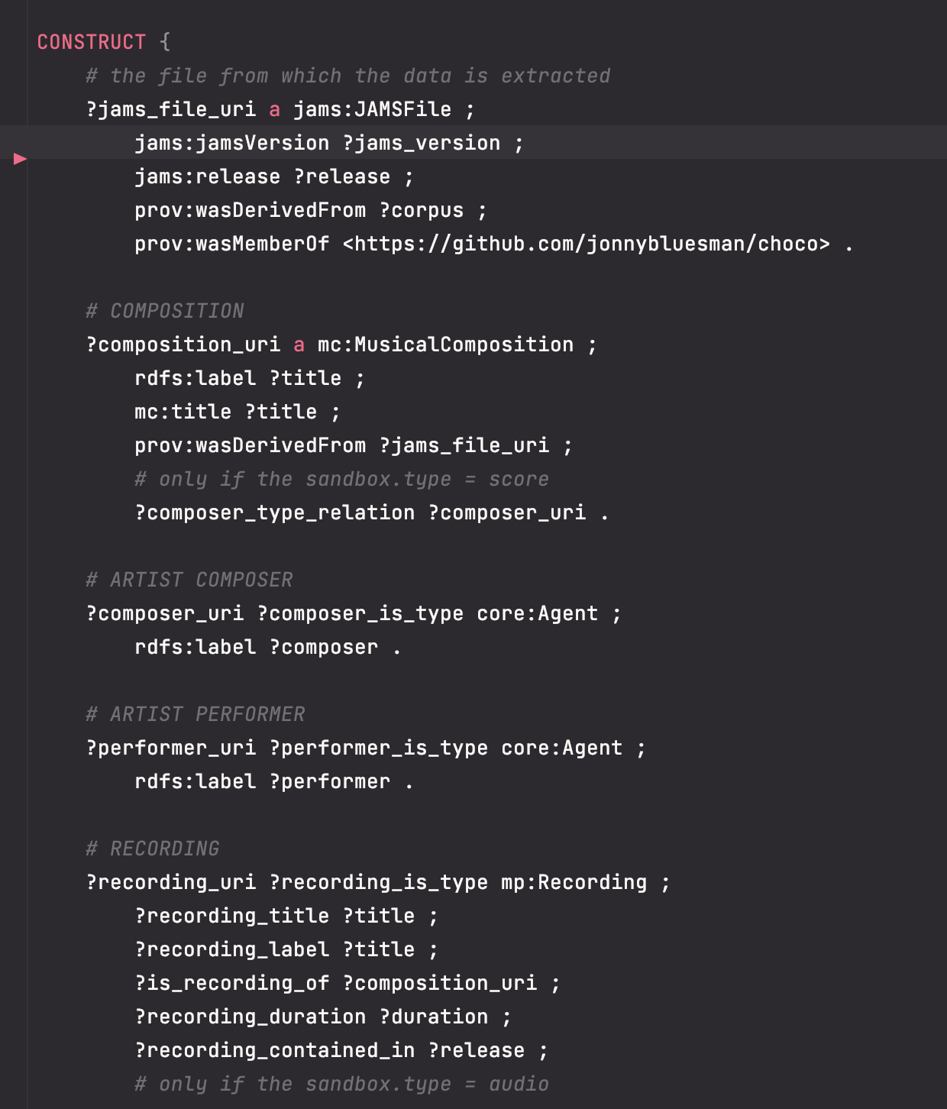
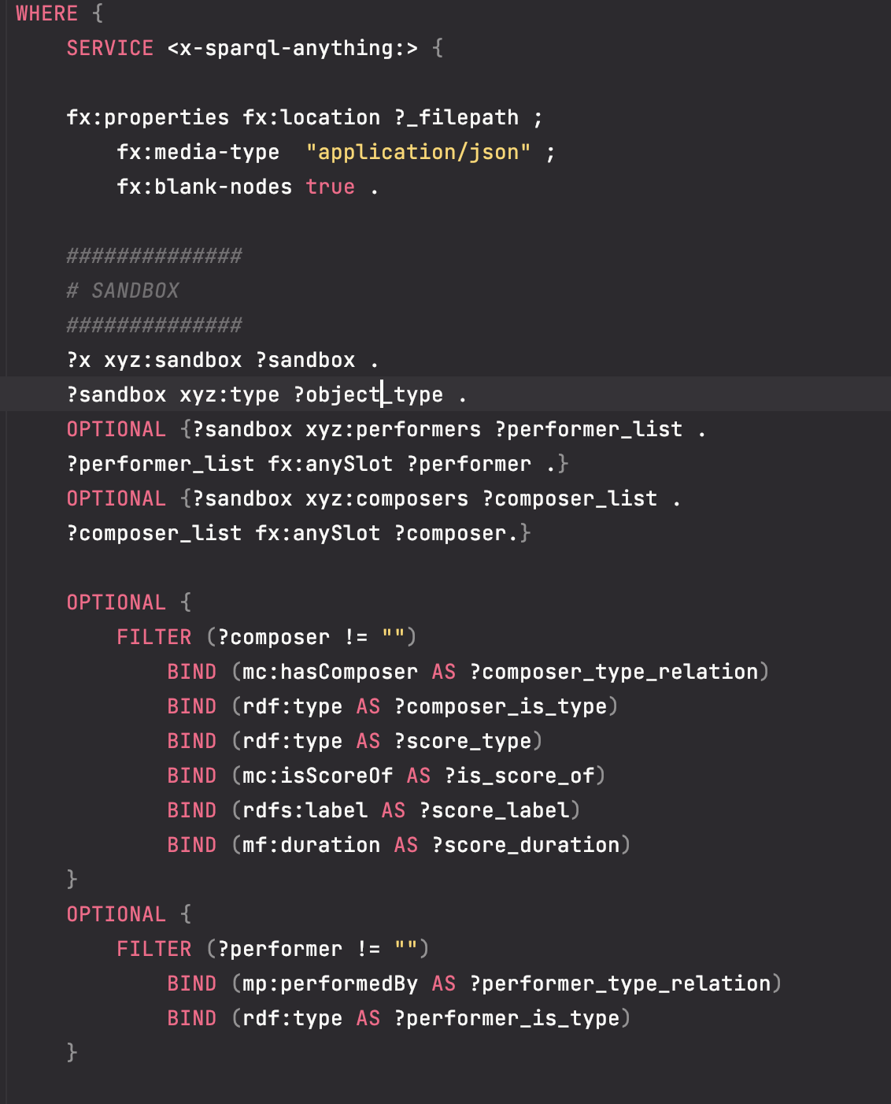
ChoCo
3. KG Generation

Slide 30
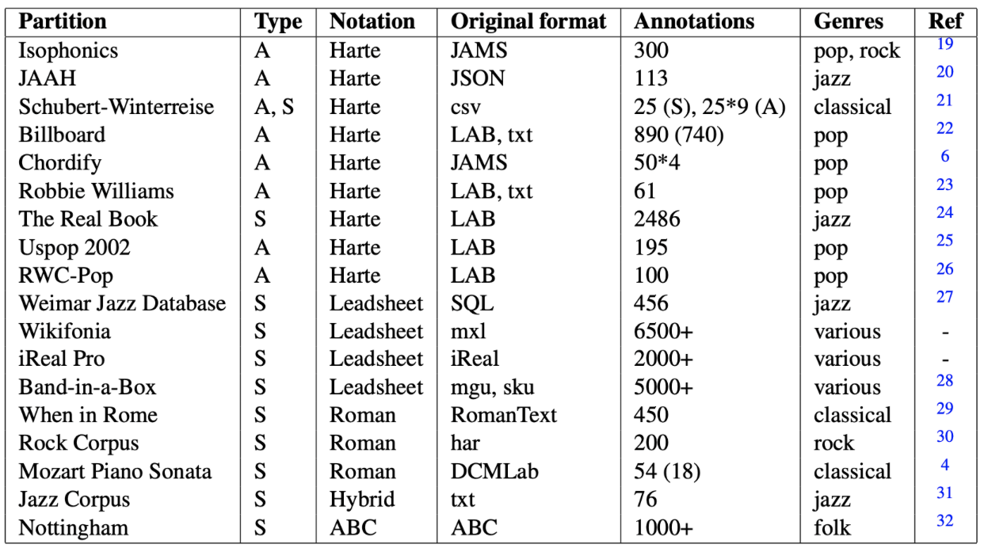
ChoCo
Overview of ChoCo’s content
20K+ JAMS files
with 42K+ different annotations
~21K chord annotations (Harte)
20K+ of tonality and modulations.
554 structural annotations
286 beat annotations 711 unique external identifiers
1,642,625 chord occurrences
7,281 possible chord classes (Harte).

Slide 31
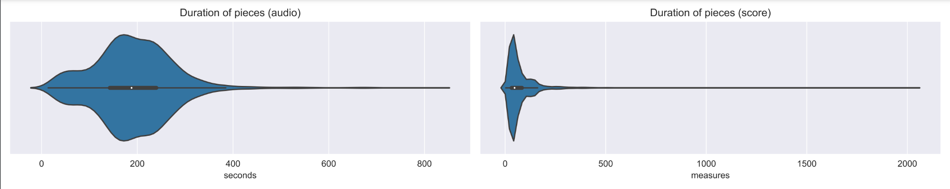
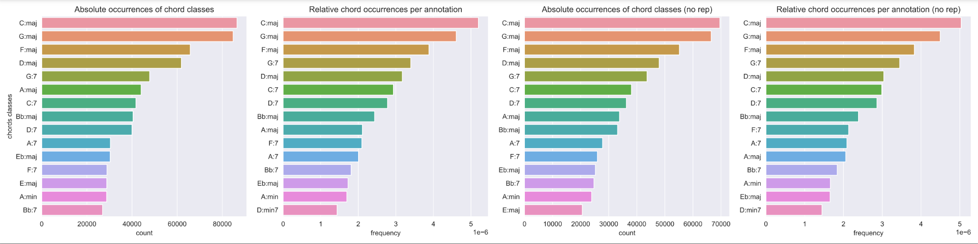
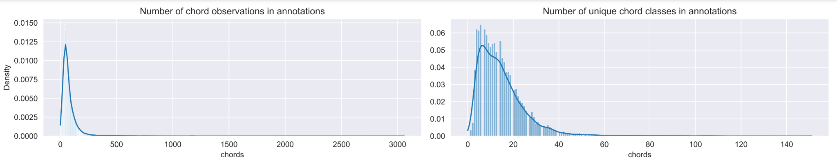
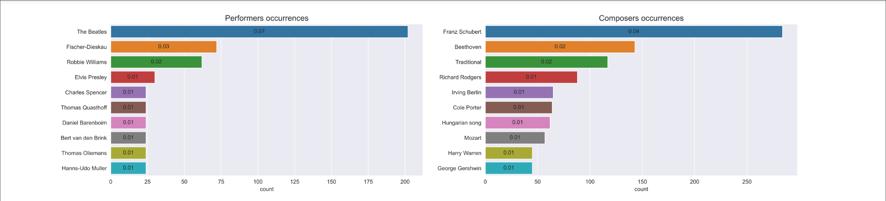
ChoCo
ChoCo: some statistics
Durations
Chords Classes
μ = 191 ; σ = 85 (s)
μ = 74 ; σ = 82 (m)
Chord Numbers
Performers/Composers
μ = 2.85 ; σ = 12.55 (s)
μ = 3.19 ; σ = 8.59 (b)

Slide 32
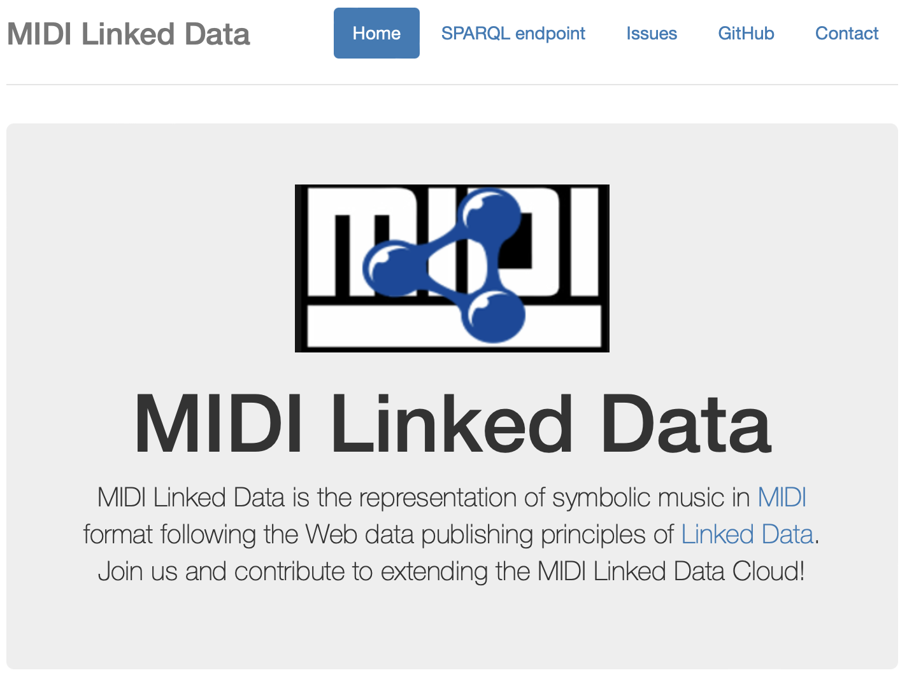
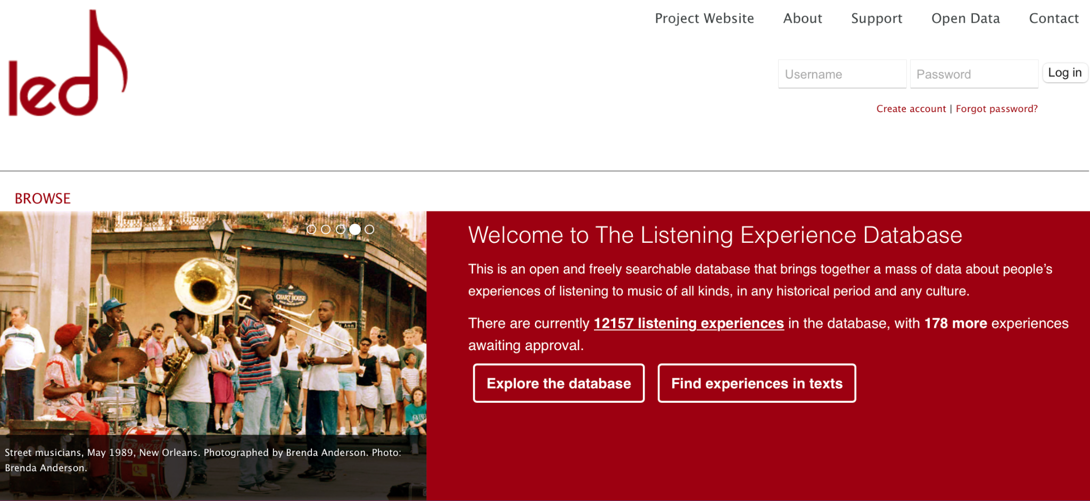
ChoCo
Links to external resources
2.4K links to MIDI-LD, ~2K to LED
Additional links open up new research directions
Relating harmonic content (chord changes, harmonic complexity, tension, etc.) to other musical properties that are inherently present in the music (melodic contour, expressive variations, instrumental changes, etc.), or that may have been elicited certain emotions, memories, and feelings to listeners.
Example of listening experience of the “So What” (J. Coltrane) in LED (~/led/lexp/1431335026178)
«What do you mean by playing "without harmony"? Using a pedal tone, which Coltrane got into after a period of very dense harmonic playing. He would use one or two harmonic references throughout a song, as he did on "So What" [from Miles Davis’s Kind of Blue, on Columbia]. It was basically D for sixteen bars, E flat for eight bars, and then back to D. Ultimately, he worked with only one harmonic reference point, and then in "Ascension" [from Best of John Coltrane: His Greatest Years, on Impulse] there was nothing harmonically.»
(Steve Kuhn in “The Great Jazz Pianists: Speaking of Their Lives and Music

Slide 33
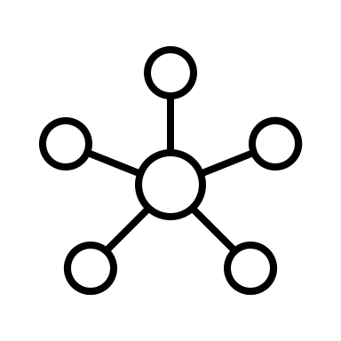

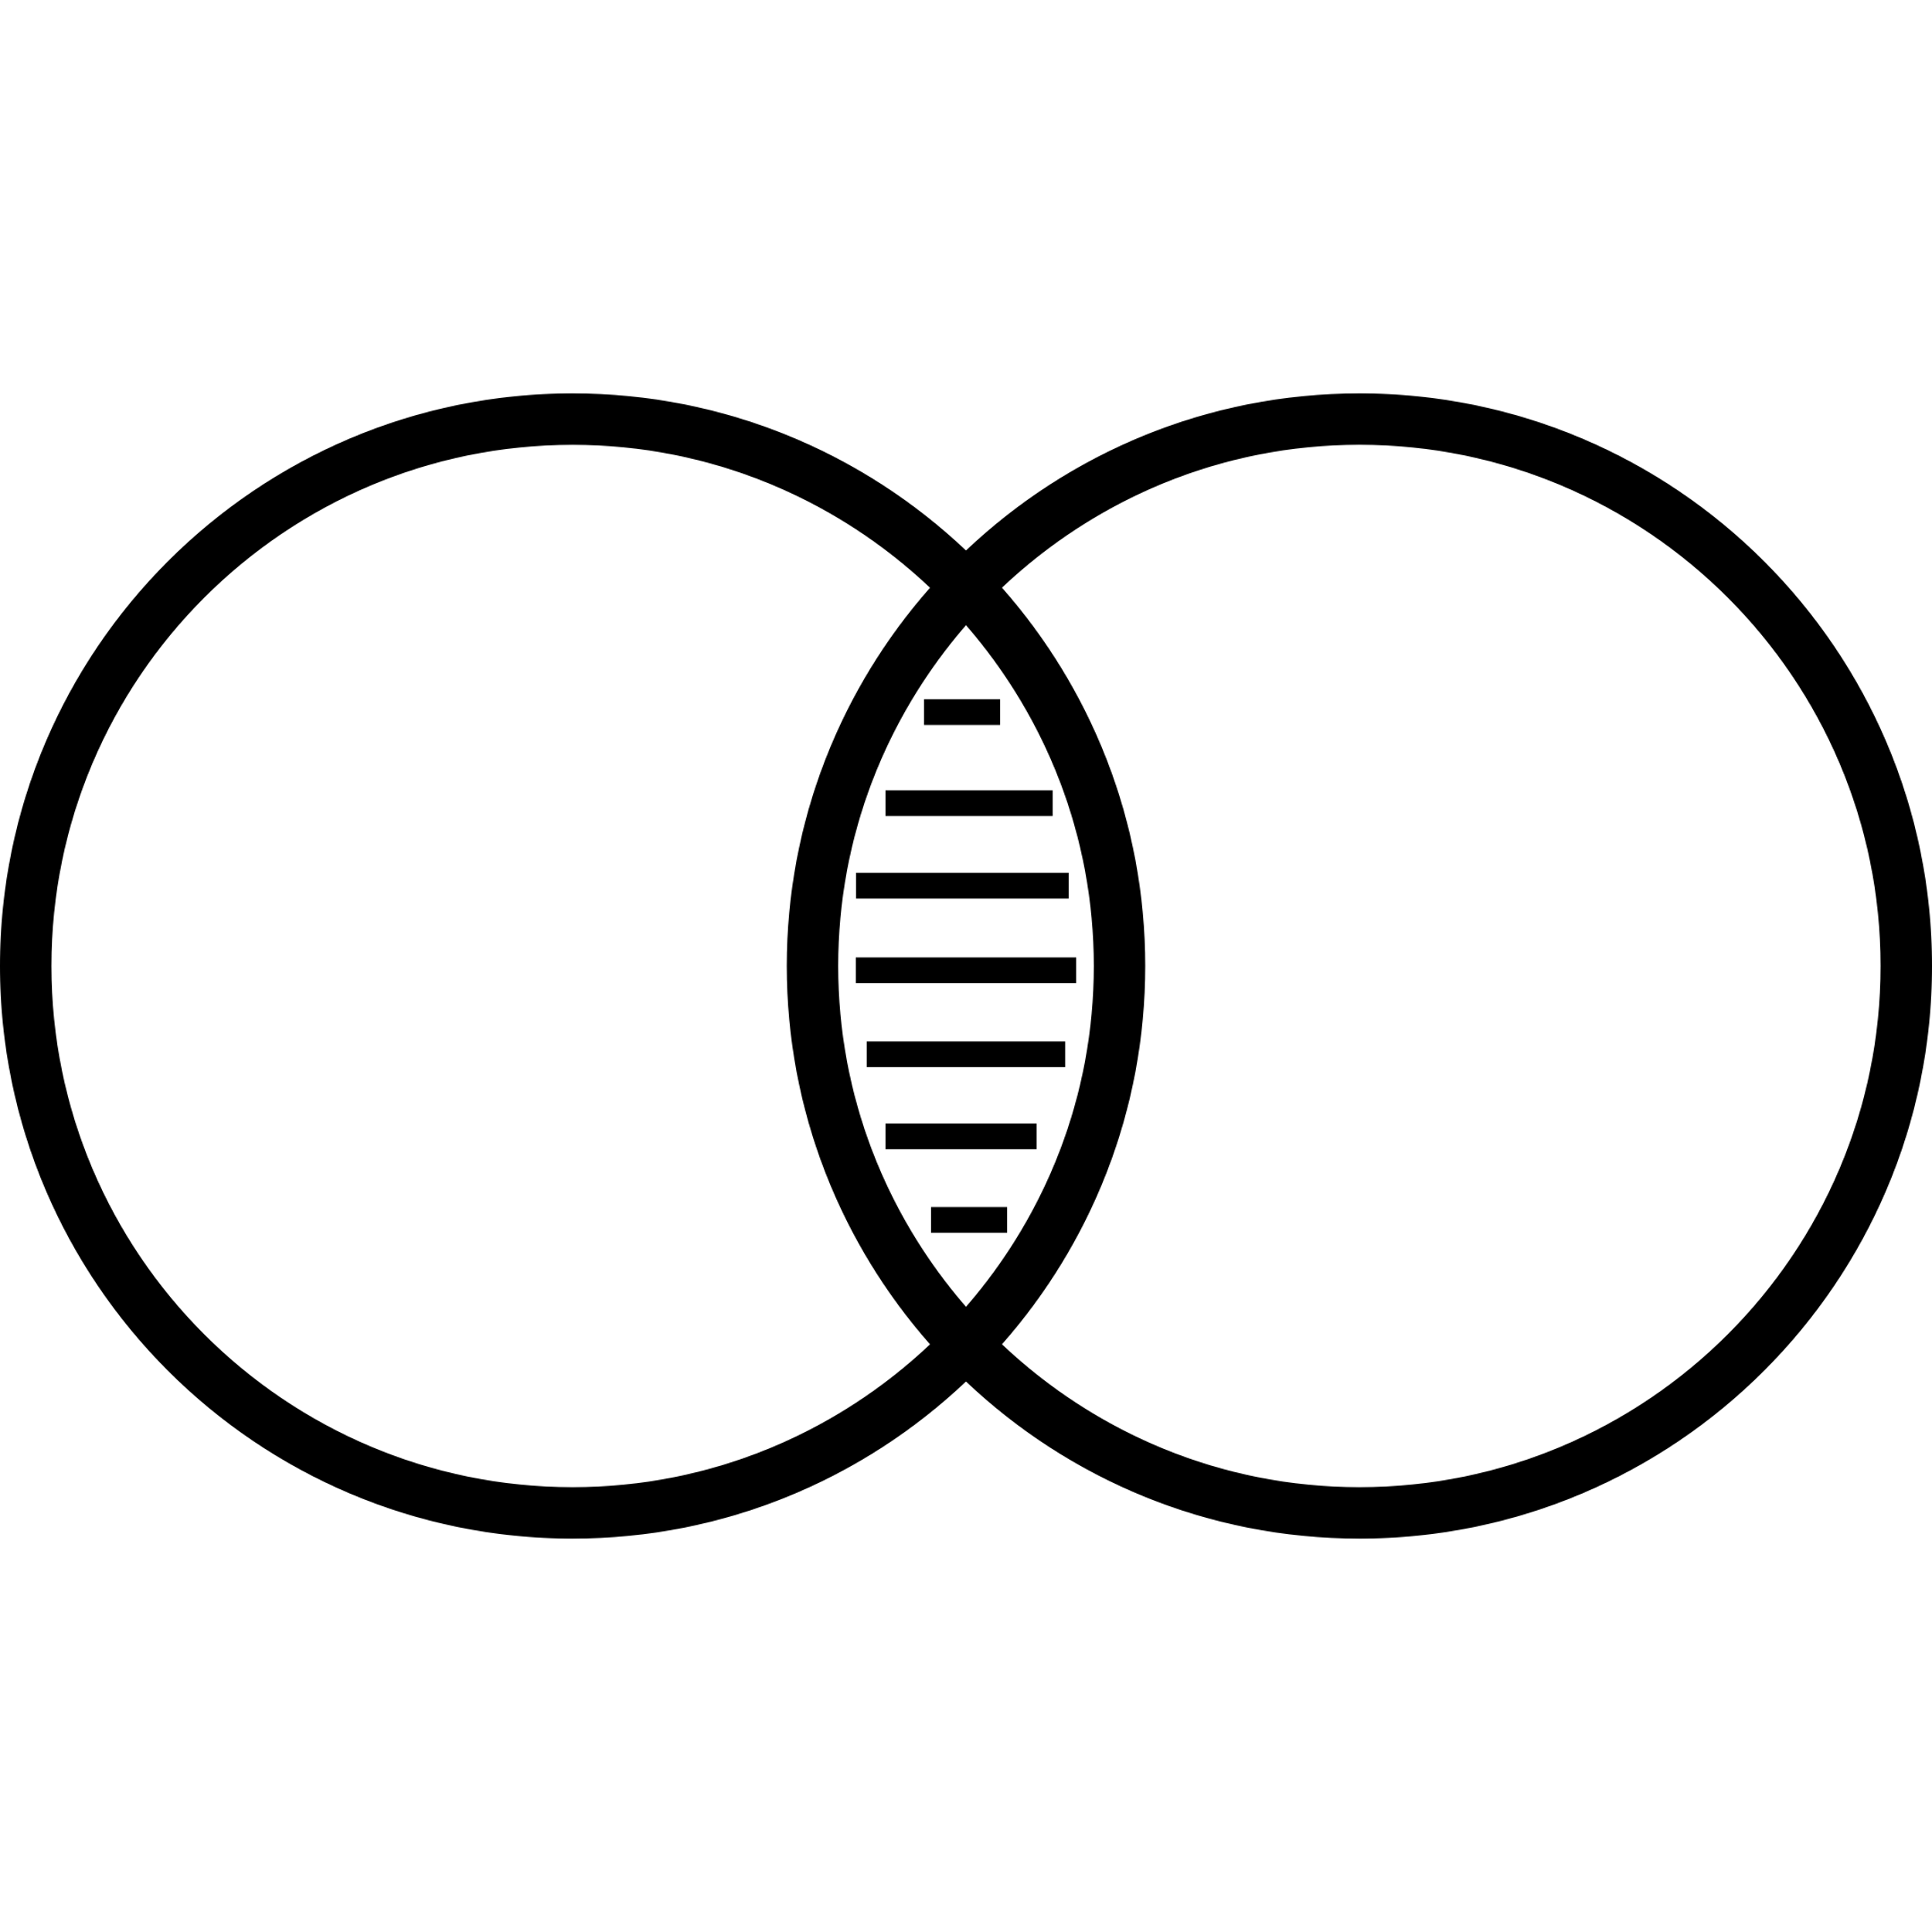
Harmory in a nutshell
Harmory is a resource
Harmory is Knowledge Graph (KG)
Harmory contains harmonic data
Harmory contains:
Segmented harmonic patterns
Similarity information
Harmory can be used for AI creativity
Harmory can be used a trustworthy framework for computational creativity

Slide 34

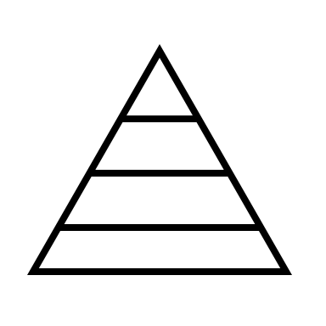
Encoding chords in the Tonal Pitch Space
Harmory: the Harmonic Memory
Novelty-based harmonic segmentation
The creation of the Harmonic Memory can be summarised in four main steps
Linking harmonic segments via similarity
Knowledge Graph creation

Slide 35
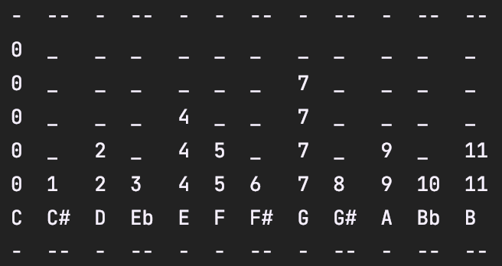
1. Encoding Chords in the Tonal Pitch Space (TPS)
The TPS provides a scoring mechanism that predicts the proximity between two musical chords.
It is based on the Generative Theory of Tonal Music and it is musicologically grounded.
It is composed by five levels:
Root level
Fifths level
Triadic level
Diatonic level
Chromatic level
Example of a C major chord levels of the TPS

Slide 36
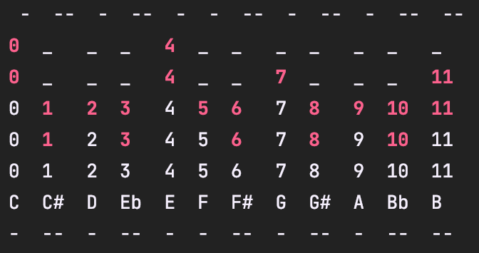
1. Encoding Chords in the Tonal Pitch Space (TPS) (2)
The TPS distance between two chords (A and B) is calculated considering:
Number of non-common pitch classes divided by 2 in the levels (𝑖-𝑖𝑣)
Minimum number of Circle-of-Fifths rule applications to shift between chord A and B
+
Difference between a C major and a E major chords according to the TPS

Slide 37
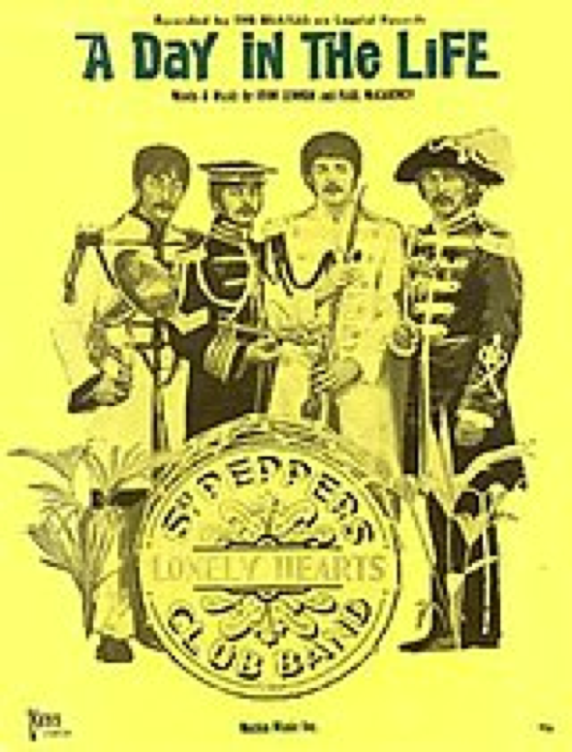
1. Encoding Chords in the Tonal Pitch Space (TPS) (3)
For a chord sequence, each chord is encoded as its distance to its local key.
For each comparison between two chords, the TPS returns a value in [0, 13].
Chord sequence (c): [G, B:min, E:min7, . . . ]
Tonal keys of c (k): [(G, major), (G, major), (G, major), . . . ]
Onsets (t): [1, 3, 5, . . . ]
TPS sequence: [2.0, 3.5, 0.0, 8.9, …]

Slide 38
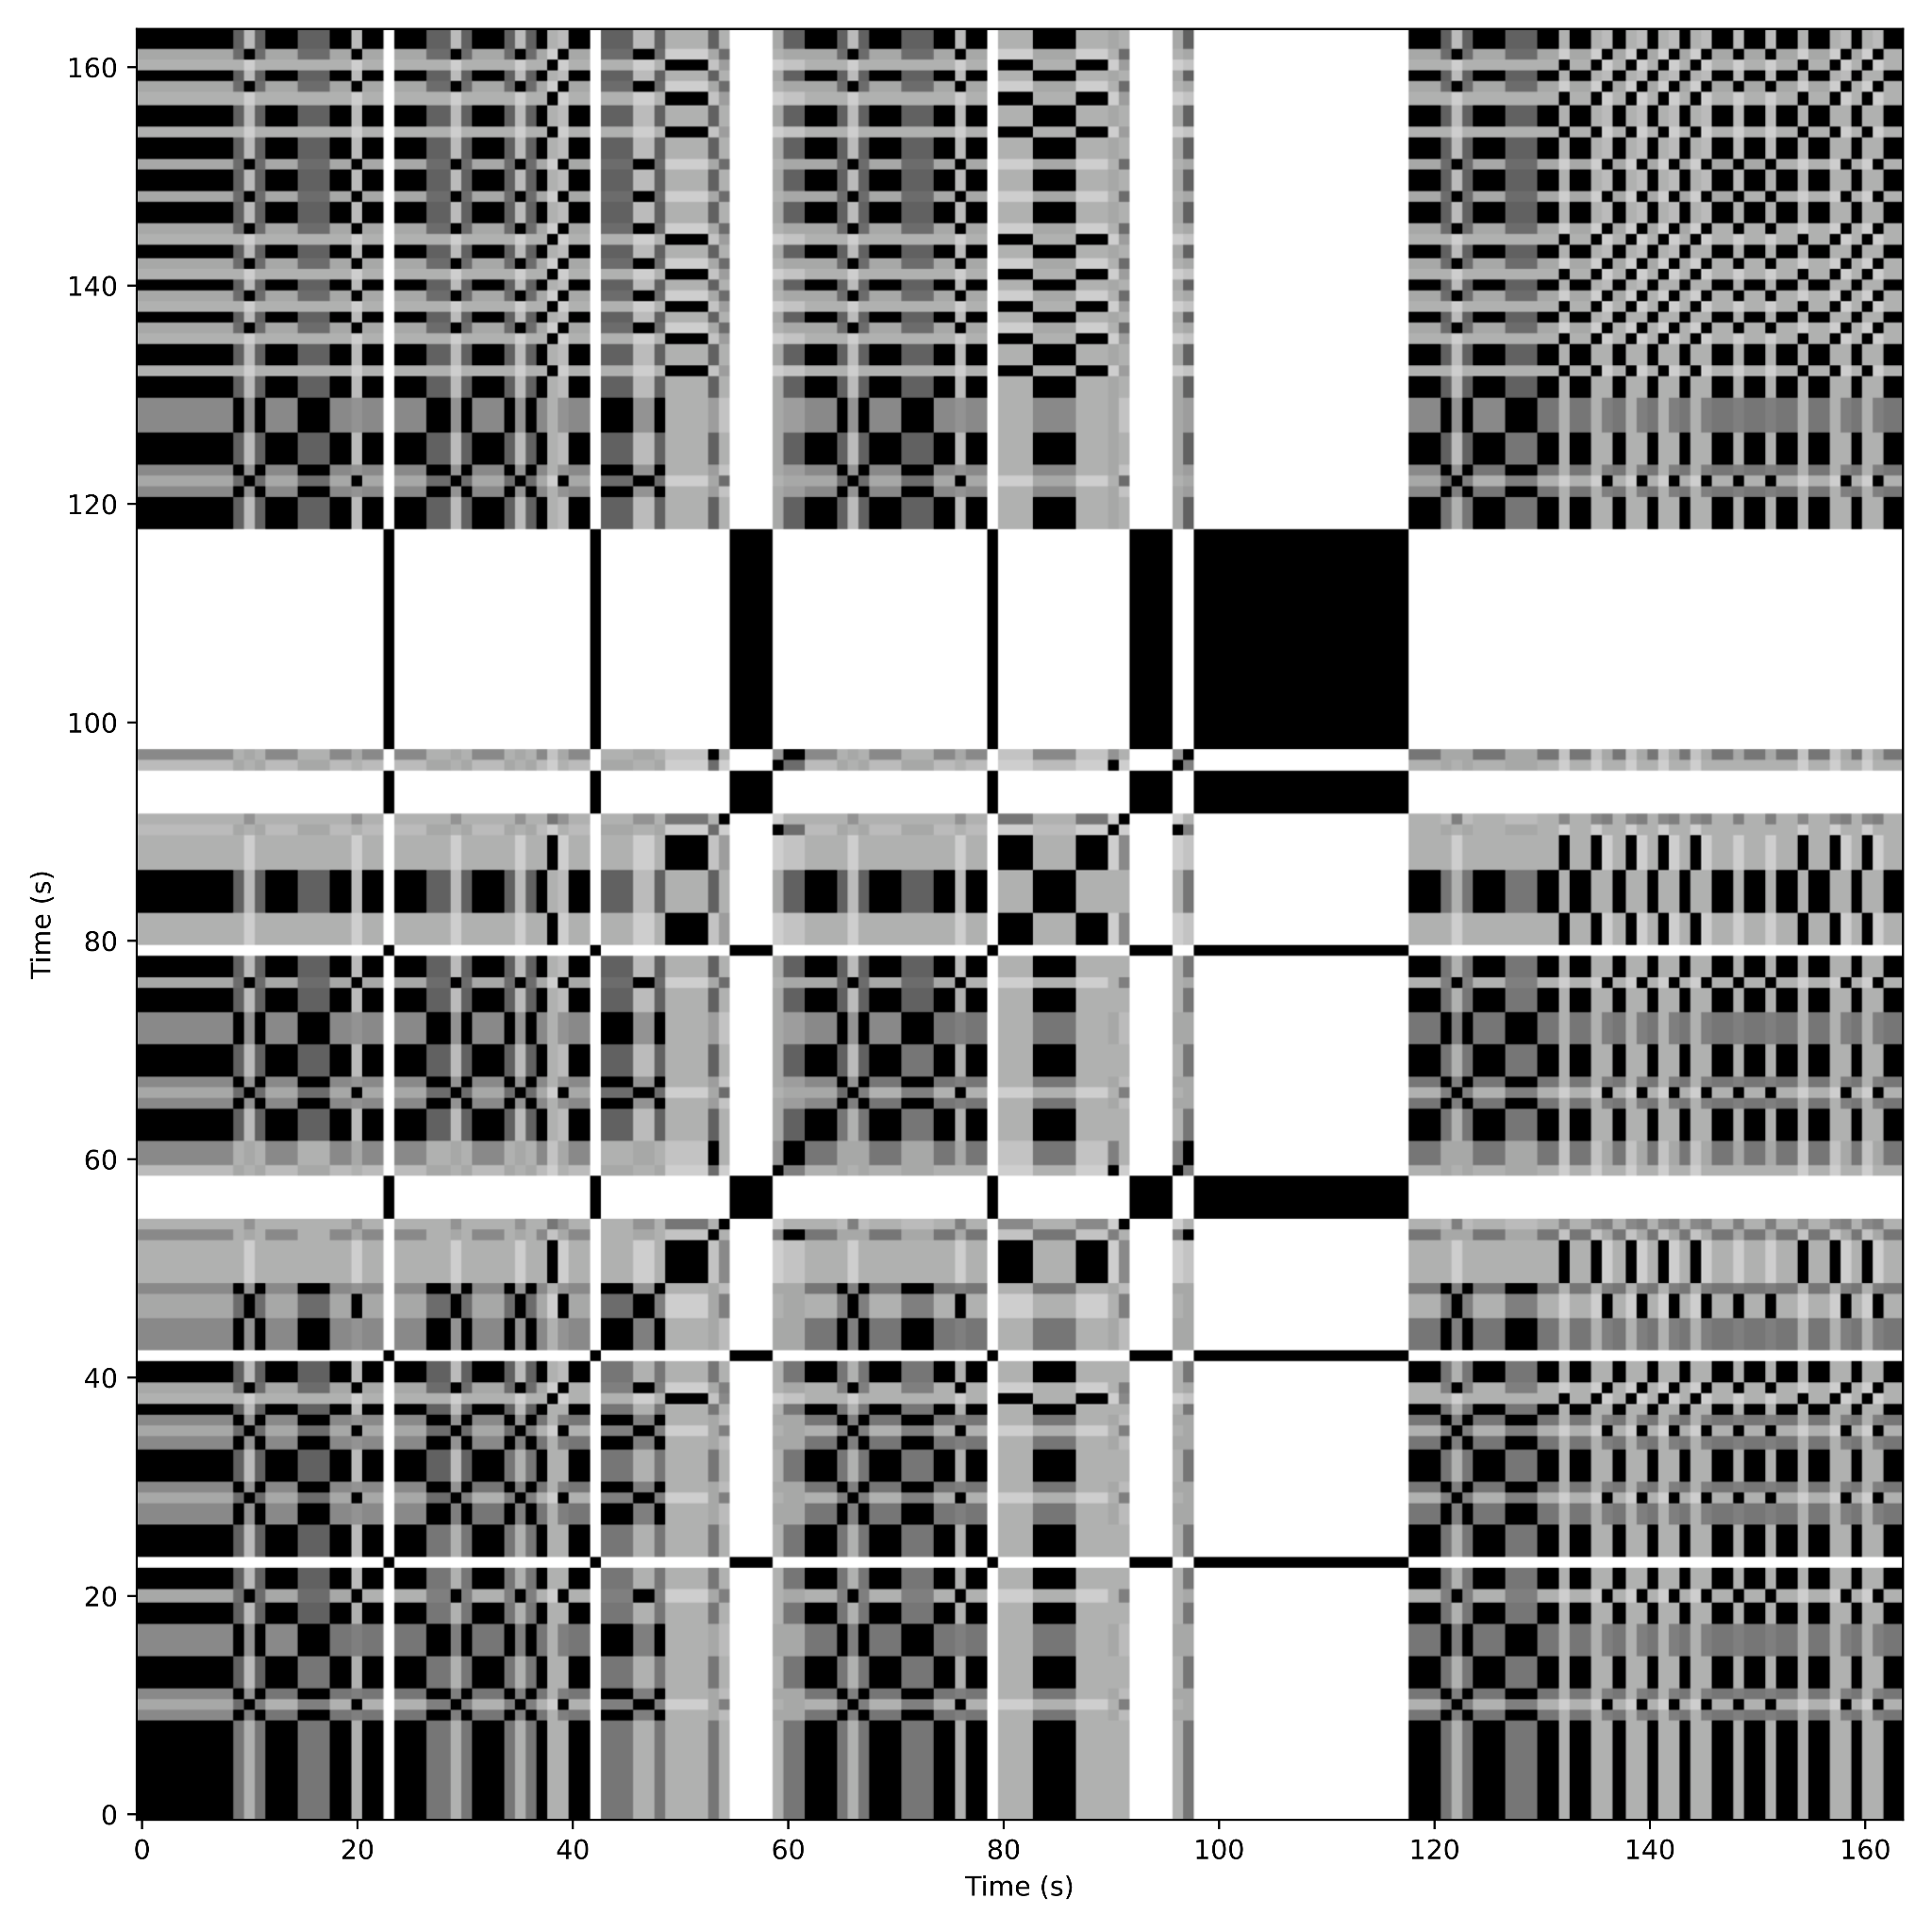
2. Novelty-based Harmonic Segmentation
A Self Similarity Matrix (SSM) is encoded starting from the TPS sequences
Self-similarity matrices have been extensively used for structure analysis on the audio signal, due to their ability to reveal nested structural elements
SSM of the track “Crazy Little Thing called Love”

Slide 39
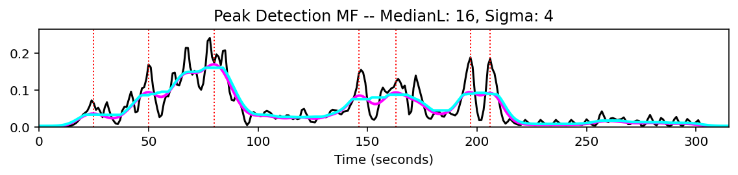
2. Novelty-based Harmonic Segmentation (2)
To identify boundaries a checkboard kernel (K) is slided along the SSM main diagonal: this creates a Novelty Curve:
- When K is located in a uniform region, novelty will be low
- When K is at the crux of a checkerboard-like structure, novelty will be high
Local maxima of the novelty curve are then used to detect the boundaries of neighbouring segments
Example of a C major chord levels of the TPS

Slide 40
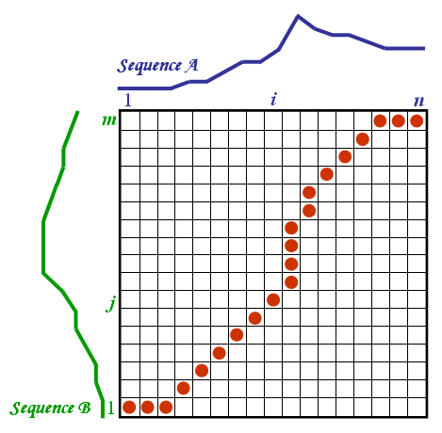
3. Linking Harmonic Segments via Similarity
The TPS encoded sequences are compared using a Dynamic Time Warping (DTW) algorithm
DTW is used for comparing and aligning time sequences (usually in the audio domain)
DTW allows for non-linear alignment between the time series by considering the local warping path

Slide 41
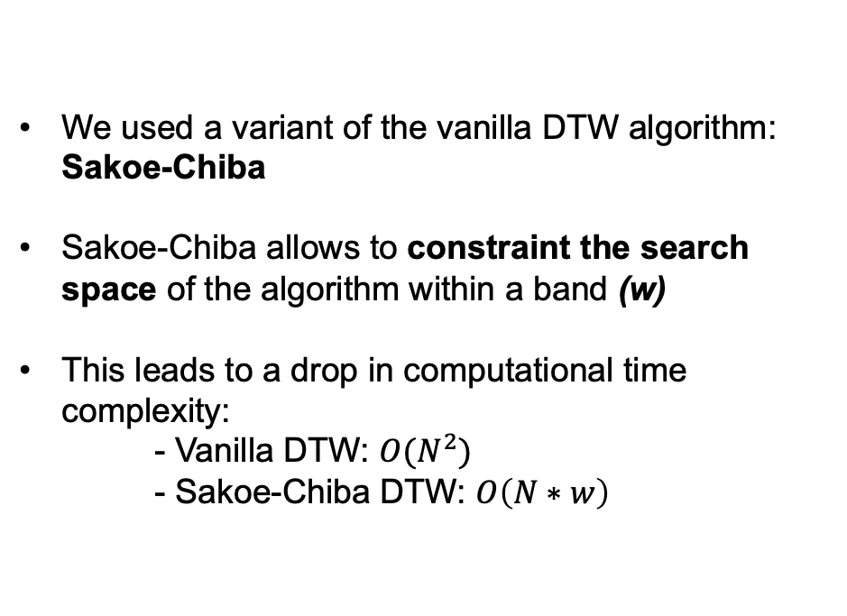
3. Linking Harmonic Segments via Similarity (2)
We used a variant of the vanilla DTW algorithm: Sakoe-Chiba
Sakoe-Chiba allows to constraint the search space of the algorithm within a band (w)
This leads to a drop in computational time complexity:
- Vanilla DTW: $O(N^{2})$
- Sakoe-Chiba DTW: $O\left(N∗w\right)$
Notes:
Pathological warping

Slide 42
4. Knowledge Graph Creation
An ontology for describing Harmory data has been created
The ontology is part of the Polifonia Ontology Network (PON)
Data has been transformed using RDFLib
The generated Knowledge Graph contains 1429070 triples

Slide 43
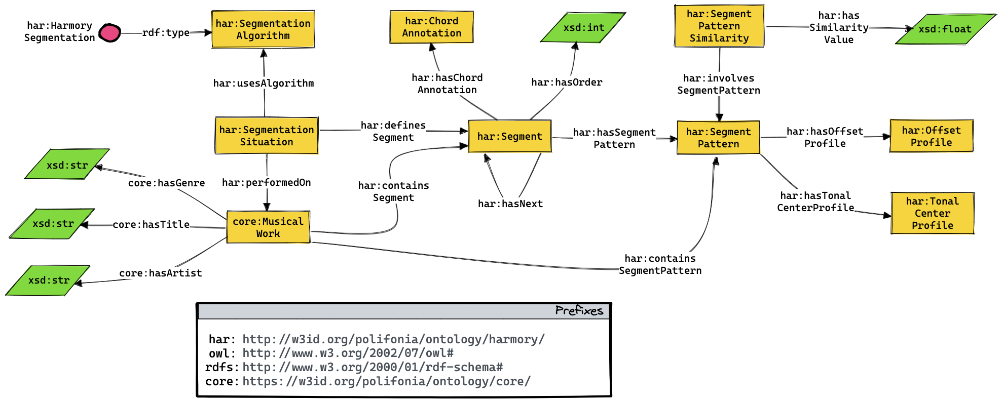
4. Knowledge Graph Creation (2)

Slide 44
Avenues for Computational Creativity: 1 – Pattern Discovery
The traversal of the Harmonic Memory makes it possible to obtain granular information of the harmonic structure of songs
Prompt 1:
For a given pattern, which are the tracks (titles, artists and genres) in which the pattern can be found?
Prompt 2:
Which harmonic patterns are used in “Michelle” by The
Beatles, but also in a classical composition?
Prompt 3:
Which tracks include a dominant cycle in seven steps?

Slide 45
Avenues for Computational Creativity: 2 – Chord Generation
Harmory also enables combinational creativity use cases:
Prompt 4:
Given a chord sequence, which are its variations, and which tracks these variations belong to?
Create a progression starting with “Come Together” by The Beatles, continuing with a segment found in a Rap song, and then continuing with another by Chuck Berry and Elvis Presley
Prompt 5:

Slide 46
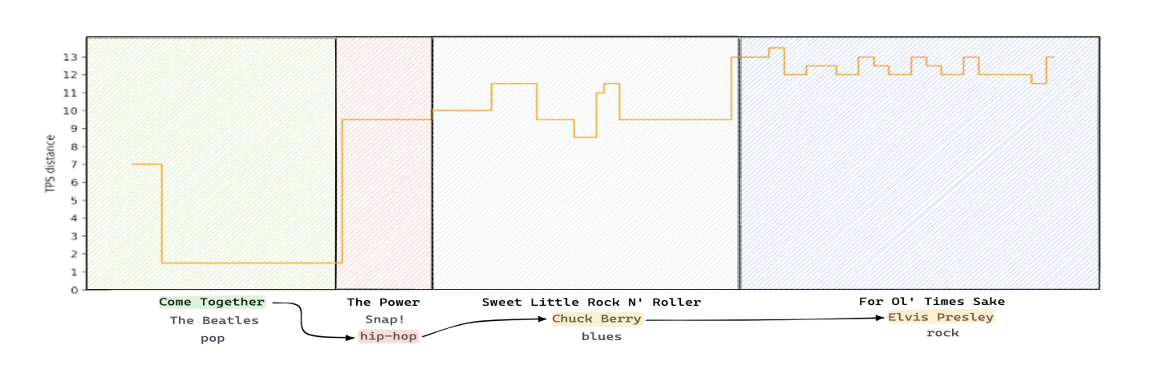
Avenues for Computational Creativity: 2 – Chord Generation

Slide 47
Avenues for Computational Creativity: 3 – Harmonic Similarity
From a musicological perspective, the KG can also be used to analyse similarity relations between tracks:
Given a track, which tracks contain patterns with a distance of less than 0.2?
Prompt 6:

Slide 48
04
EXERCISE(s)

Slide 49
Task Description
The exercise consists in querying Knowledge Graphs you are not familiar with
The two knowledge graphs have been introduced during this lecture, namely:
ChoCo
Harmory
You will be provided with a sample query and a few competency questions
Working in pairs, you are asked to create SPARQL queries from:
One (or more) competency questions
New competency questions you will define (be creative!)

Slide 50
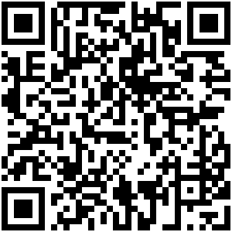
Exercise Link
https://github.com/andreamust/semantic-music-lecture

Slide 51
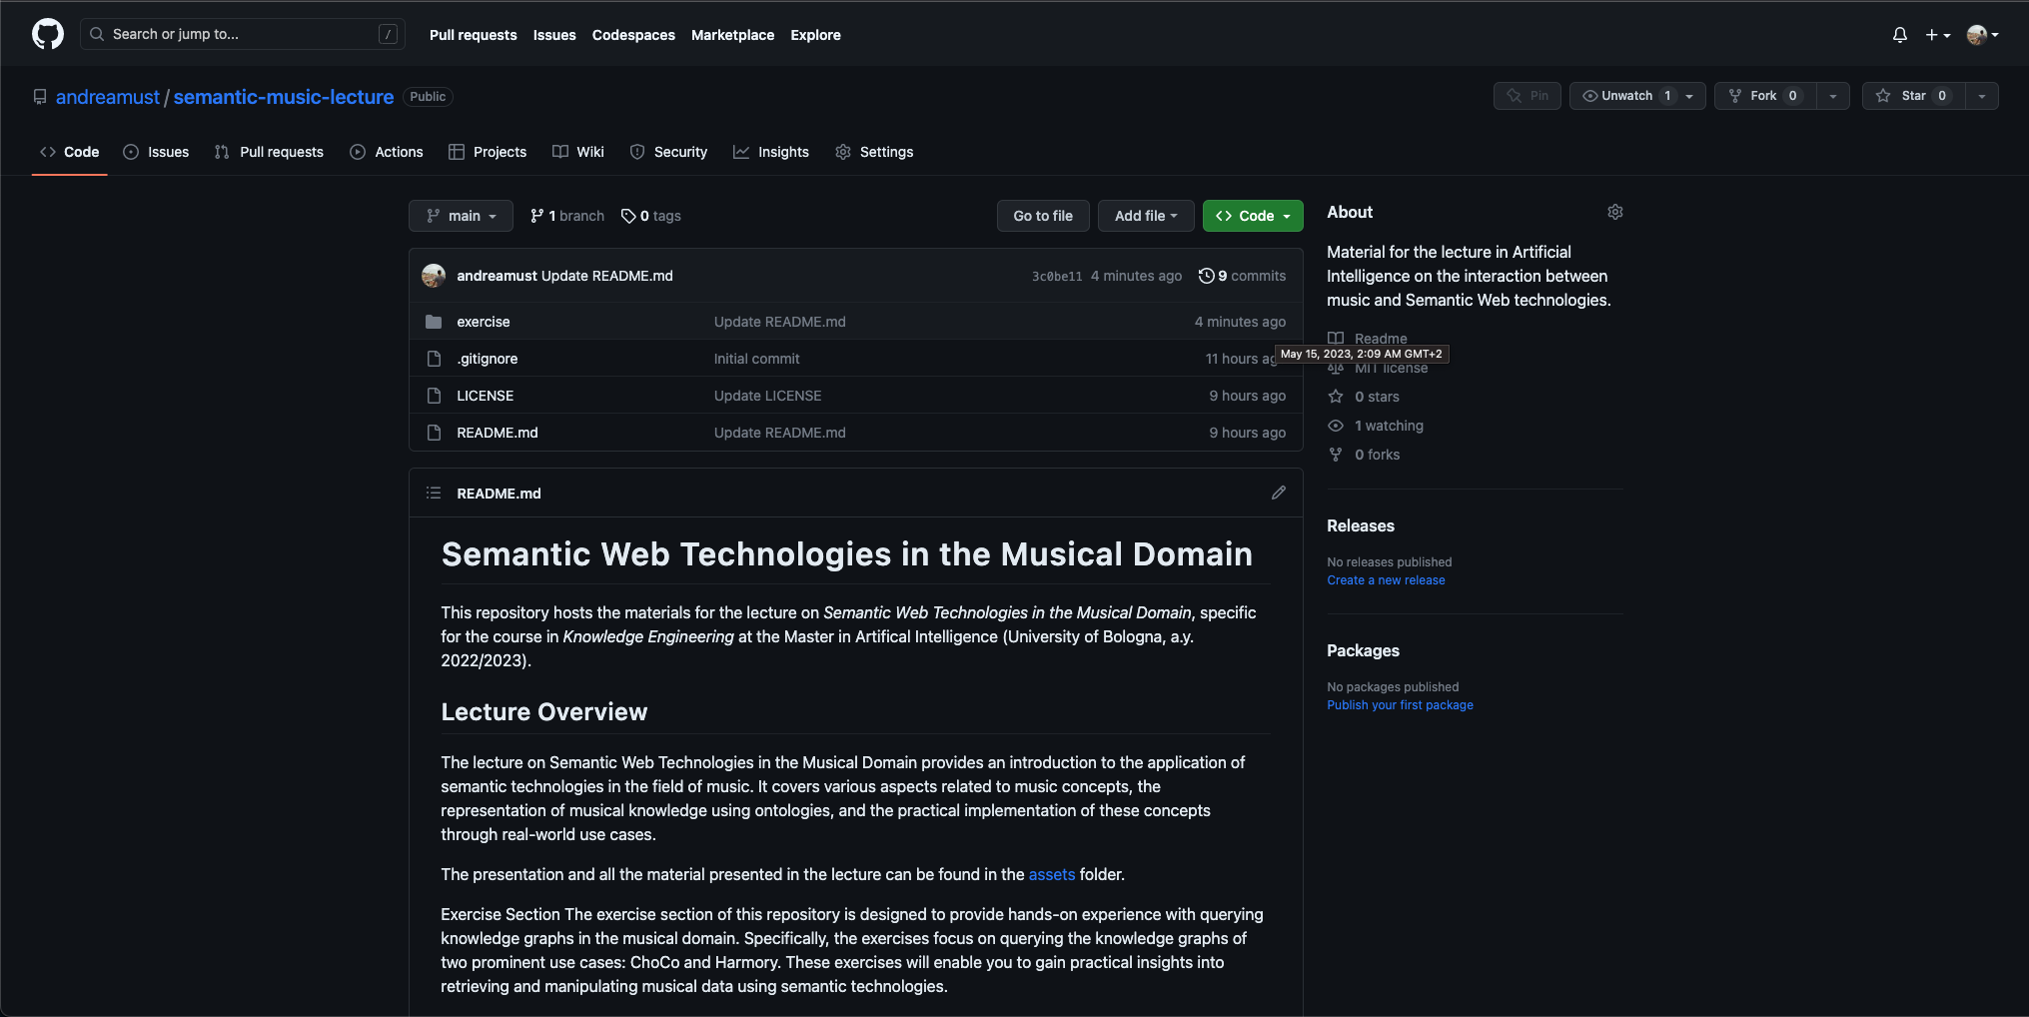
Exercise Link

Slide 52
Exercise Overview
Divide the class in pairs
Pick one project (Harmory or ChoCo)
Fork the repository
Get familiar with the Knowledge Graph and the Ontology
Write a SPARQL Query for one of the predefined Competency Questions
Create you own Competency Question
Submit you queries opening a pull-request

Slide 53

Querying ChoCo

Slide 54

Querying Harmory

Slide 55
Andrea Poltronieri
Department of Computer Science and Engineering
andrea.poltronieri2@unibo.it

